Slide 1
Knowledge Storage for Retrieval Augmented Generation
By-
Asmit Kumar Tyagi

Slide 2

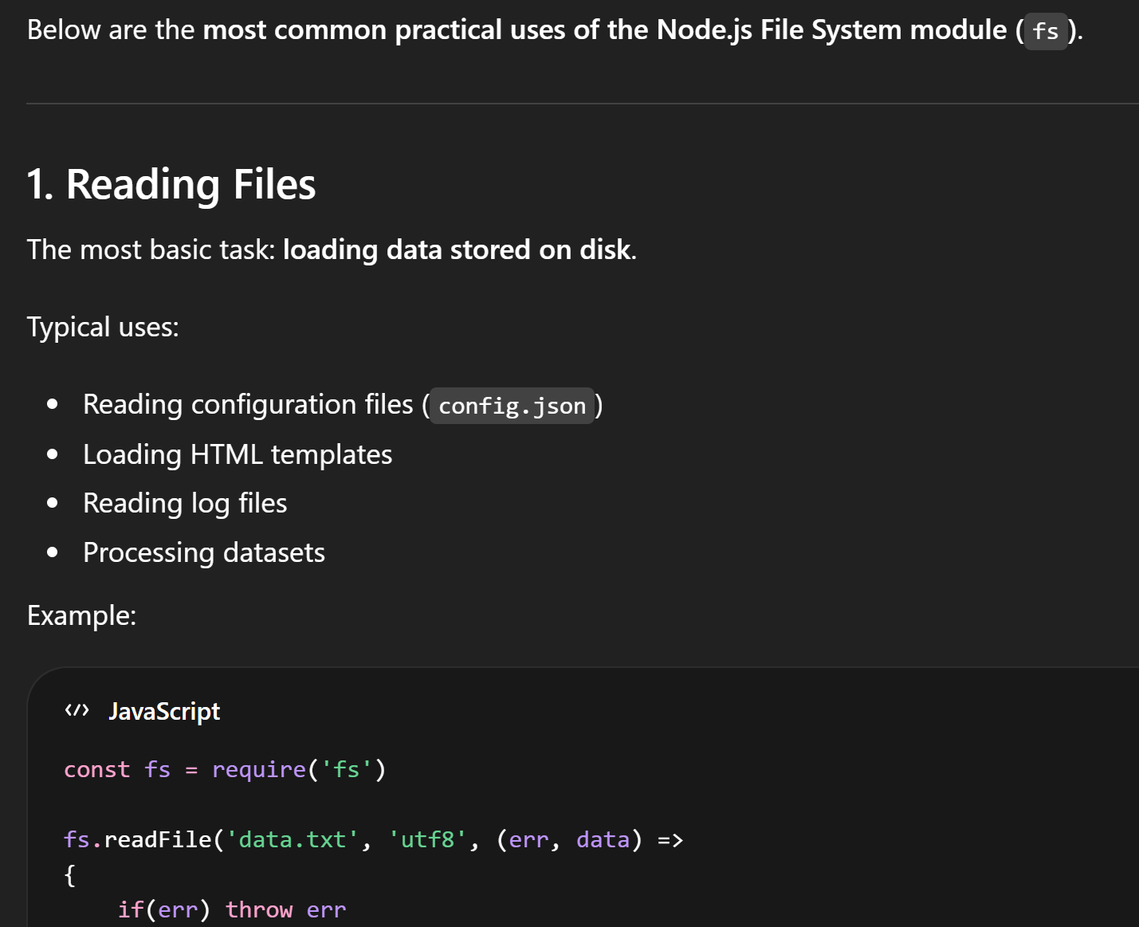
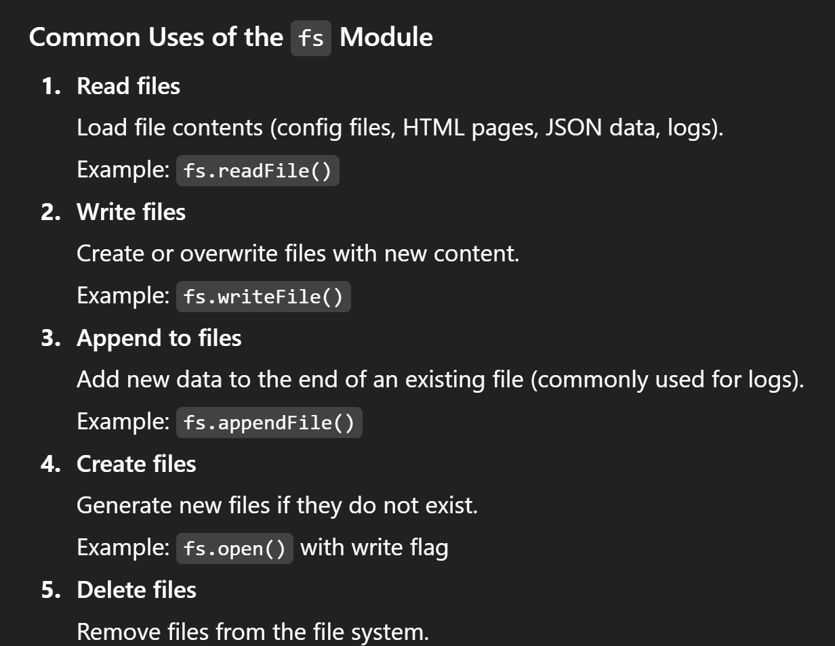
Query on trained data
Without additional context
With additional context

Slide 3

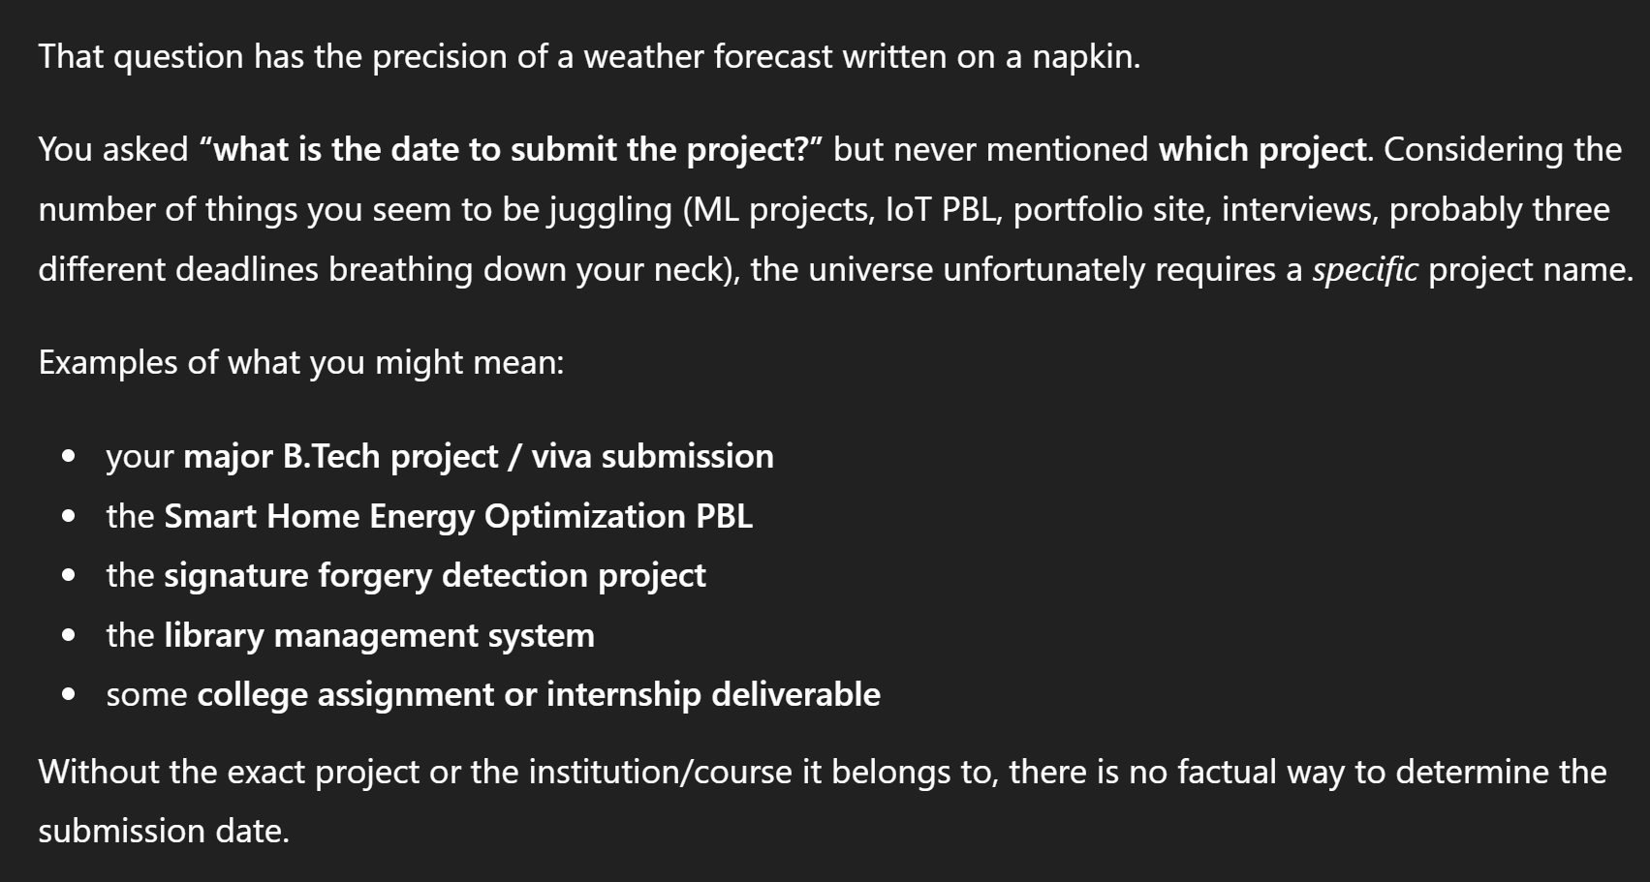
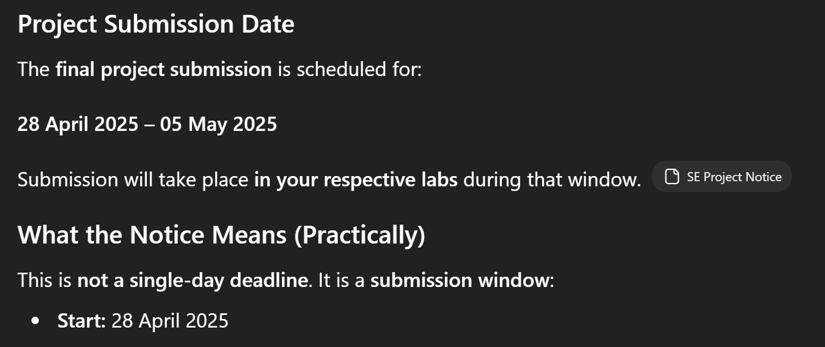
Query on Untrained Data
Without additional context
With additional context

Slide 4
Two key limitations of traditional LLMs
Outdated training data: LLMs are trained on static data, which can lead to inaccurate or outdated responses.
Hallucinations: LLMs may extrapolate or make false statements when facts are unavailable.

Slide 5
What is a Knowledge Base?
A RAG knowledge base is a specialized, external, and up-to-date repository (like PDFs, databases, or wikis) used by AI to find accurate information before answering. It acts as "trusted memory," allowing models to retrieve specific facts, reducing hallucinations, and ensuring responses are relevant and factual.

Slide 6
Why is a Knowledge Base important?
Eliminating Hallucinations and Ensuring Reliability
Contextual accuracy
Managing Dynamic and Proprietary Data

Slide 7
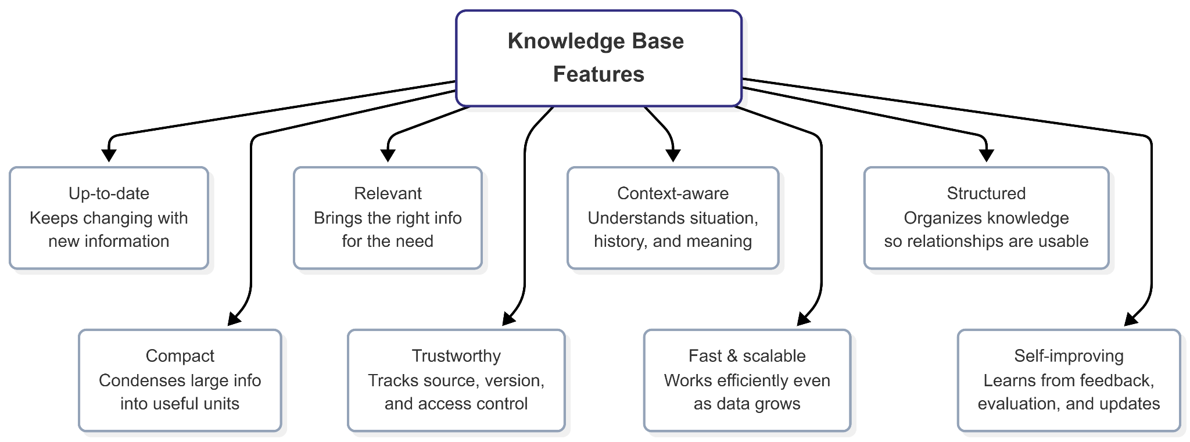

Slide 8
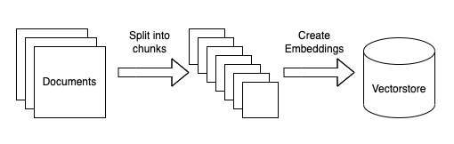
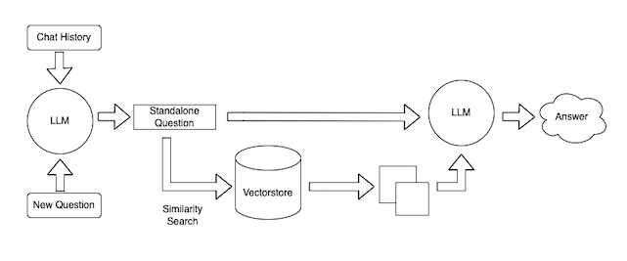
Offline Phase
Online Phase

Slide 9
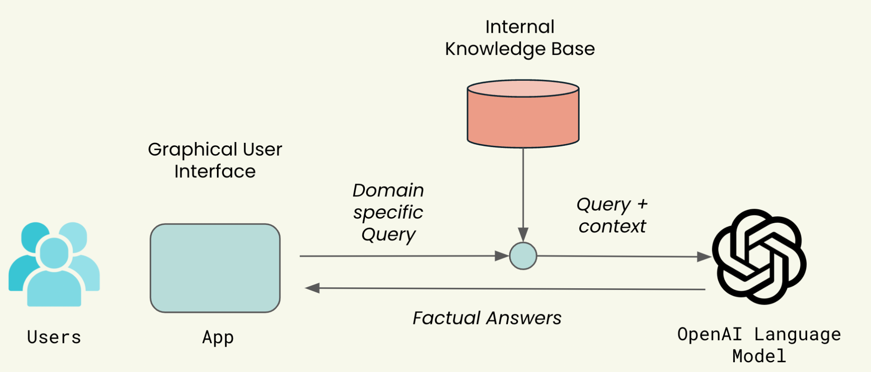

Slide 10
Types of features of KBs based on architecture
Meaning-based search -> Vector database
Context of situation (time, source, user, tags) -> Metadata indexing
Exact values, records, IDs -> Relational database
Keyword or phrase matching -> Inverted index / search engine
Multi-hop reasoning -> Knowledge graph
Hierarchies and relationships -> Graph / ontology-based KB
Combining accuracy + semantics -> Hybrid architecture

Slide 11
Conclusion
Knowledge bases are important because they make AI systems more accurate, contextual, and reliable
They organize documents, metadata, structured data, and relationships into a usable knowledge source
In the future, knowledge bases will support enterprise search, domain-specific assistants, decision support, and multi-step reasoning
As AI systems grow, knowledge bases will become a key foundation for scalable and trustworthy intelligent applications

Slide 12
References
https://community.n8n.io/t/building-an-ai-assistant-with-my-own-knowledge-base/40255
https://loisto.ai/experience/turn-your-internal-knowledge-base-to-an-intelligent-assistant
https://building.nubank.com/ai-solution-for-search/
https://www.zendesk.com/in/service/help-center/ai-knowledge-base/

